Slide 1
Technology Review
Elizabeth Holden | Elliott Sanger | Salah Elbakri | Diane Chiang
Notes:
dataset:
Instance segmentation (object classification + detection = object classification + semantics segmentation)
https://universe.roboflow.com/mycollege/tumor-detection-2/dataset/3
semantic segmentation
https://universe.roboflow.com/tumor-azexj/tumor-vliim/dataset/4

Slide 2
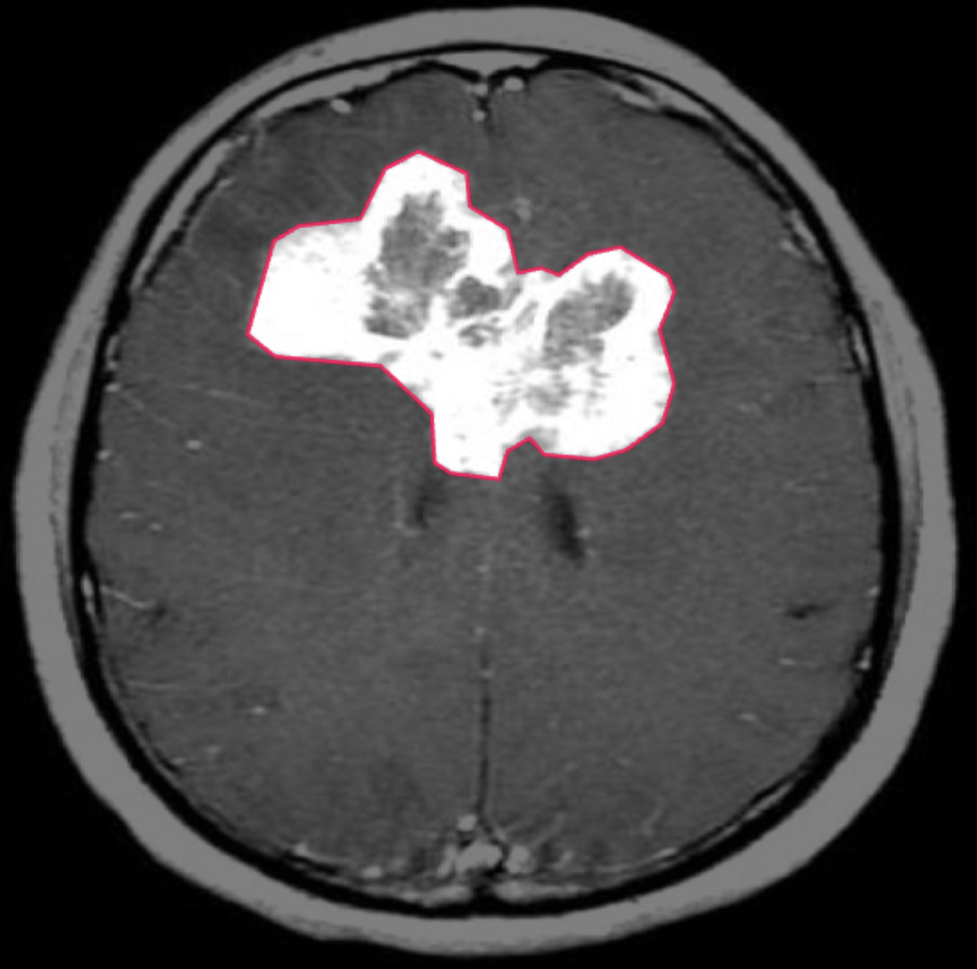
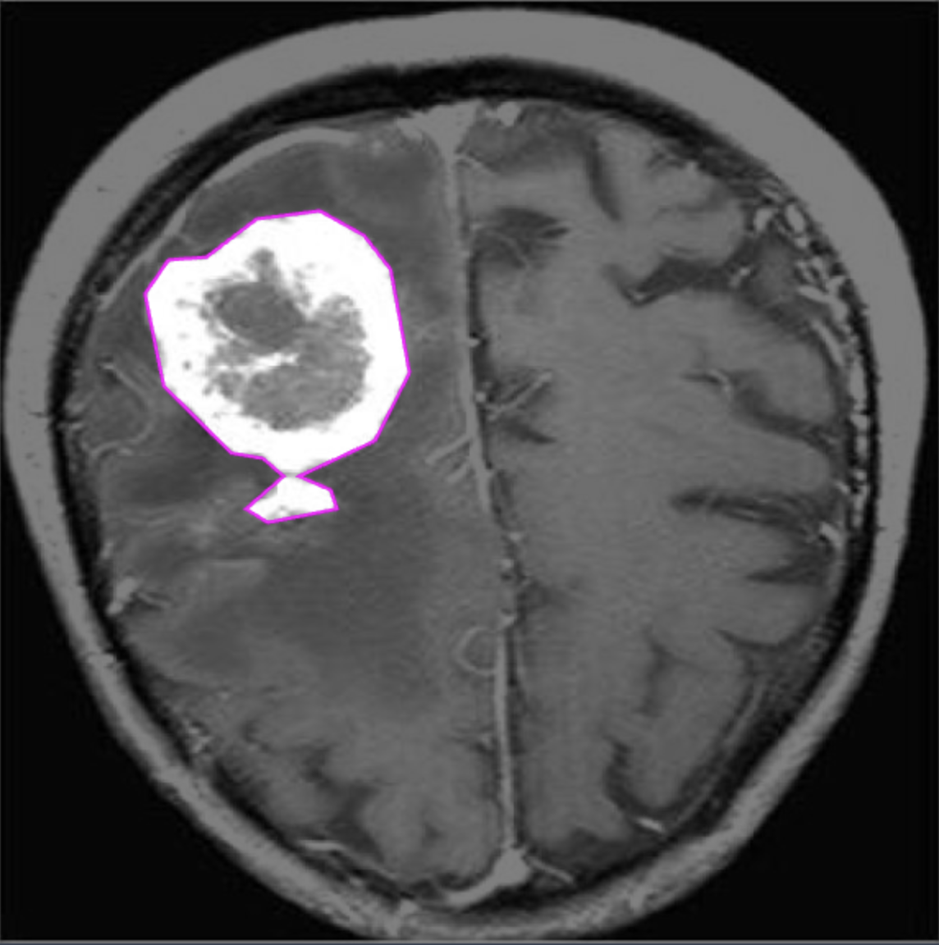
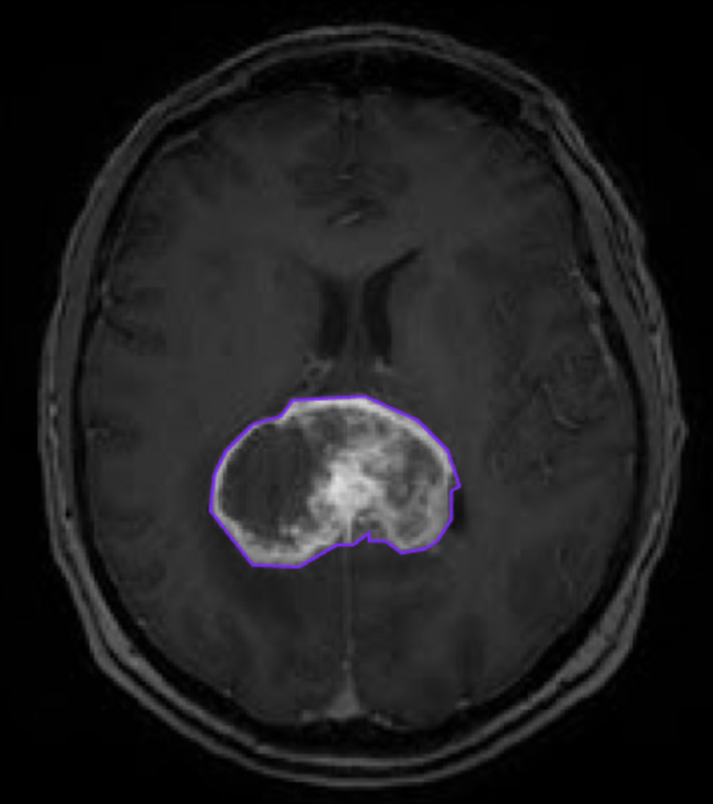
Background & Use Case
GOAL: Build website that processes uploaded brain scan images and returns the location, size, and severity of the tumor - if there is one.
Need a model that can predict the seriousness of brain tumors given the brain image
Use instance segmentation (object detection + classification) to categorize the severity of a brain tumor
User Case: Patient
Cyndi just received her diagnosis with a brain tumor at the age of 30. She received her results that showed a tumor in the early stage of development. Instead of waiting for more information from the doctor, she would like to know more about her diagnosis. What’s the size of the tumor? What’s the severity of her condition?
less chance moderate chance high chance
Notes:
What’s your application?
What use case are you trying to solve?
What about it needs a Python library?

Slide 3
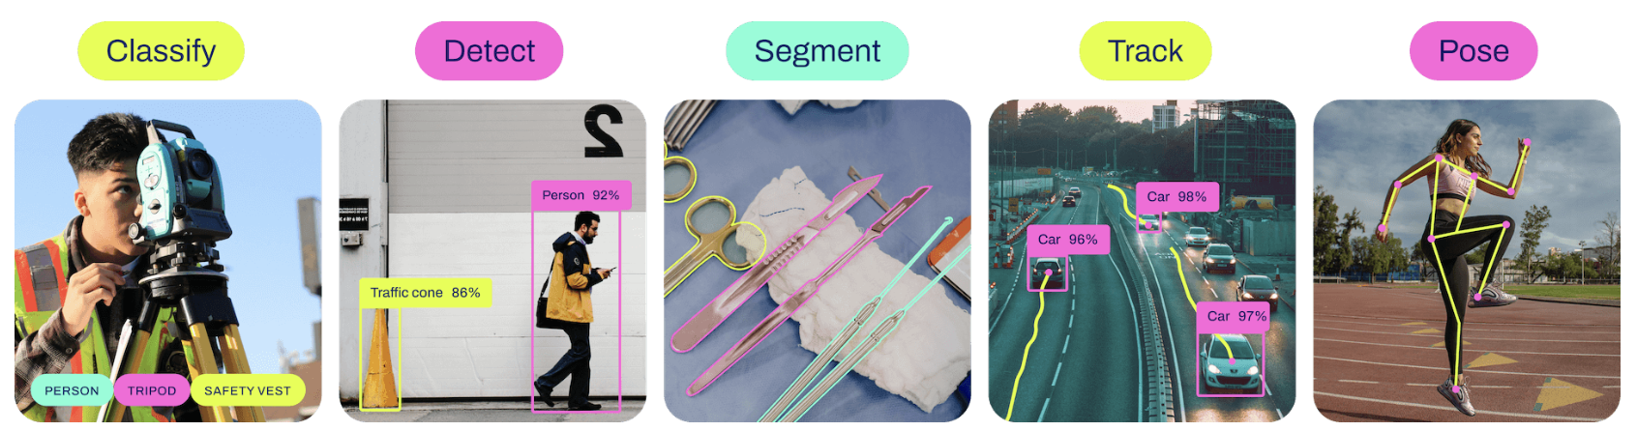
Python Package Choices 1-2
Choice 1: Ultralytics YOLOv8
Used for wide range of object detection and tracking, instance segmentation, image classification and pose estimation tasks.
Choice 2: Keras
Keras is the high-level API of the TensorFlow platform that can be used for deep learning
Notes:
Ultralytics YOLOv8
model that builds upon the success of previous YOLO versions and introduces new features and improvements to further boost performance and flexibility. YOLOv8 is designed to be fast, accurate, and easy to use, making it an excellent choice for a wide range of object detection and tracking, instance segmentation, image classification and pose estimation tasks.

Slide 4
Package Comparison: YOLOv8 vs. Keras
YOLOv8 (by Ultralytics)
Pros:
High accuracy
Easy to use
Well documented pipeline and examples for object detection and classification
Cons:
Specific required label format (ex. coordinates needs to be between (-1, 1); might need to rescale the label
Long training time of 3000+ brain CTs (100 epochs took 17+ hours)
Keras (by Google)
Pros:
Flexibility on model and training configuration
Well documented classes and examples
Cons:
Pre processing of image dataset required
Generalized deep learning, not tailored towards image segmentation
Notes:
Things to think about, as a starting point:
Addresses all requirements of your project
Compatibility with other elements of the project
Ease of use
Computational efficiency for the scale of data you’ll be using
No software bugs that will impair your use case
Availability of relevant examples

Slide 5
Our Choice: YOLOv8
Well defined functions for creating, training, and predicting with the model
No pre-processing of data needed due to the file format of training data
More examples of our specific application, object detection
YOLO (“You only look once”) model for object detection and image segmentation model created by UW alumni

Slide 6
Drawbacks & Remaining Concerns
Time consuming model training -> start training now
Low mAP (mean Average Precision) ~ 0.6 for instance segmentation
Scale back to semantics segmentation
“Black-box model” - with so many parameters and configurations available - it’s difficult to interpret the key features.
Research into YOLOv8 architecture and understand it
YOLOv8 architecture explained
Notes:
Is there anything in the “con” list to be concerned about?
Will you have to mitigate any drawbacks?
What will you watch out for?

Slide 7
Package Demonstration
LIVE DEMO

